Slide 1
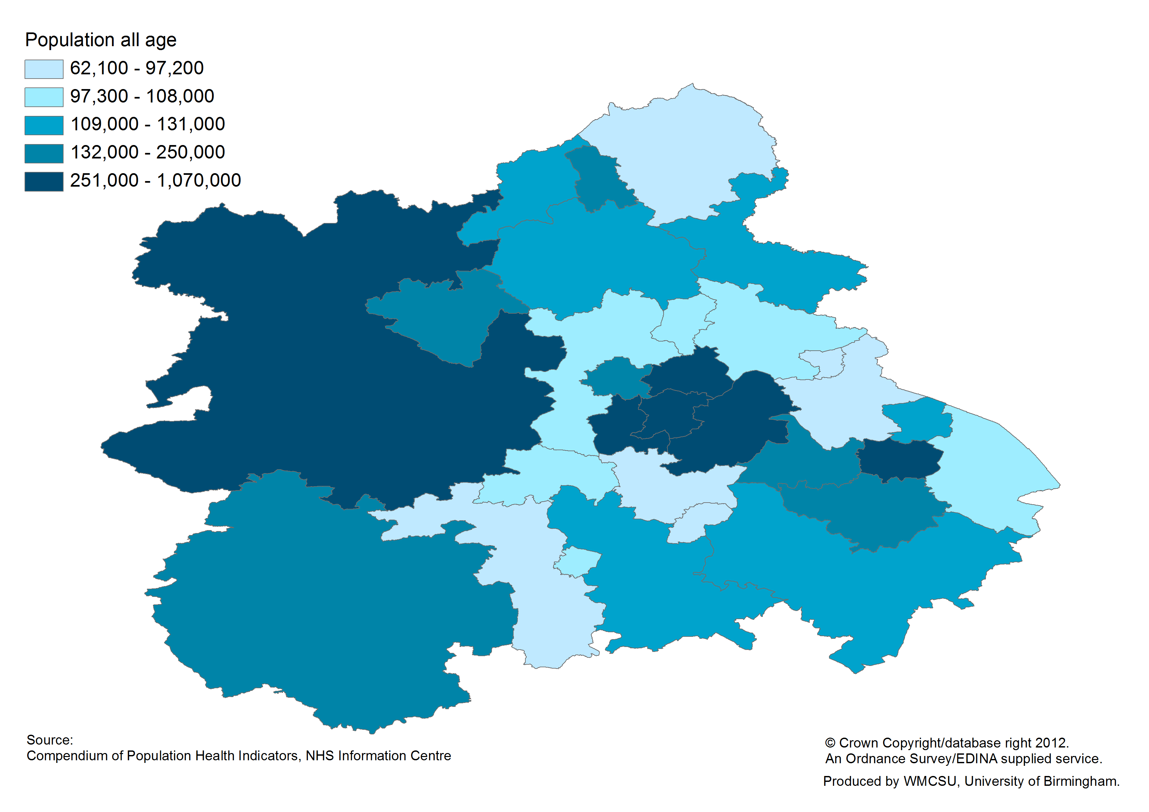
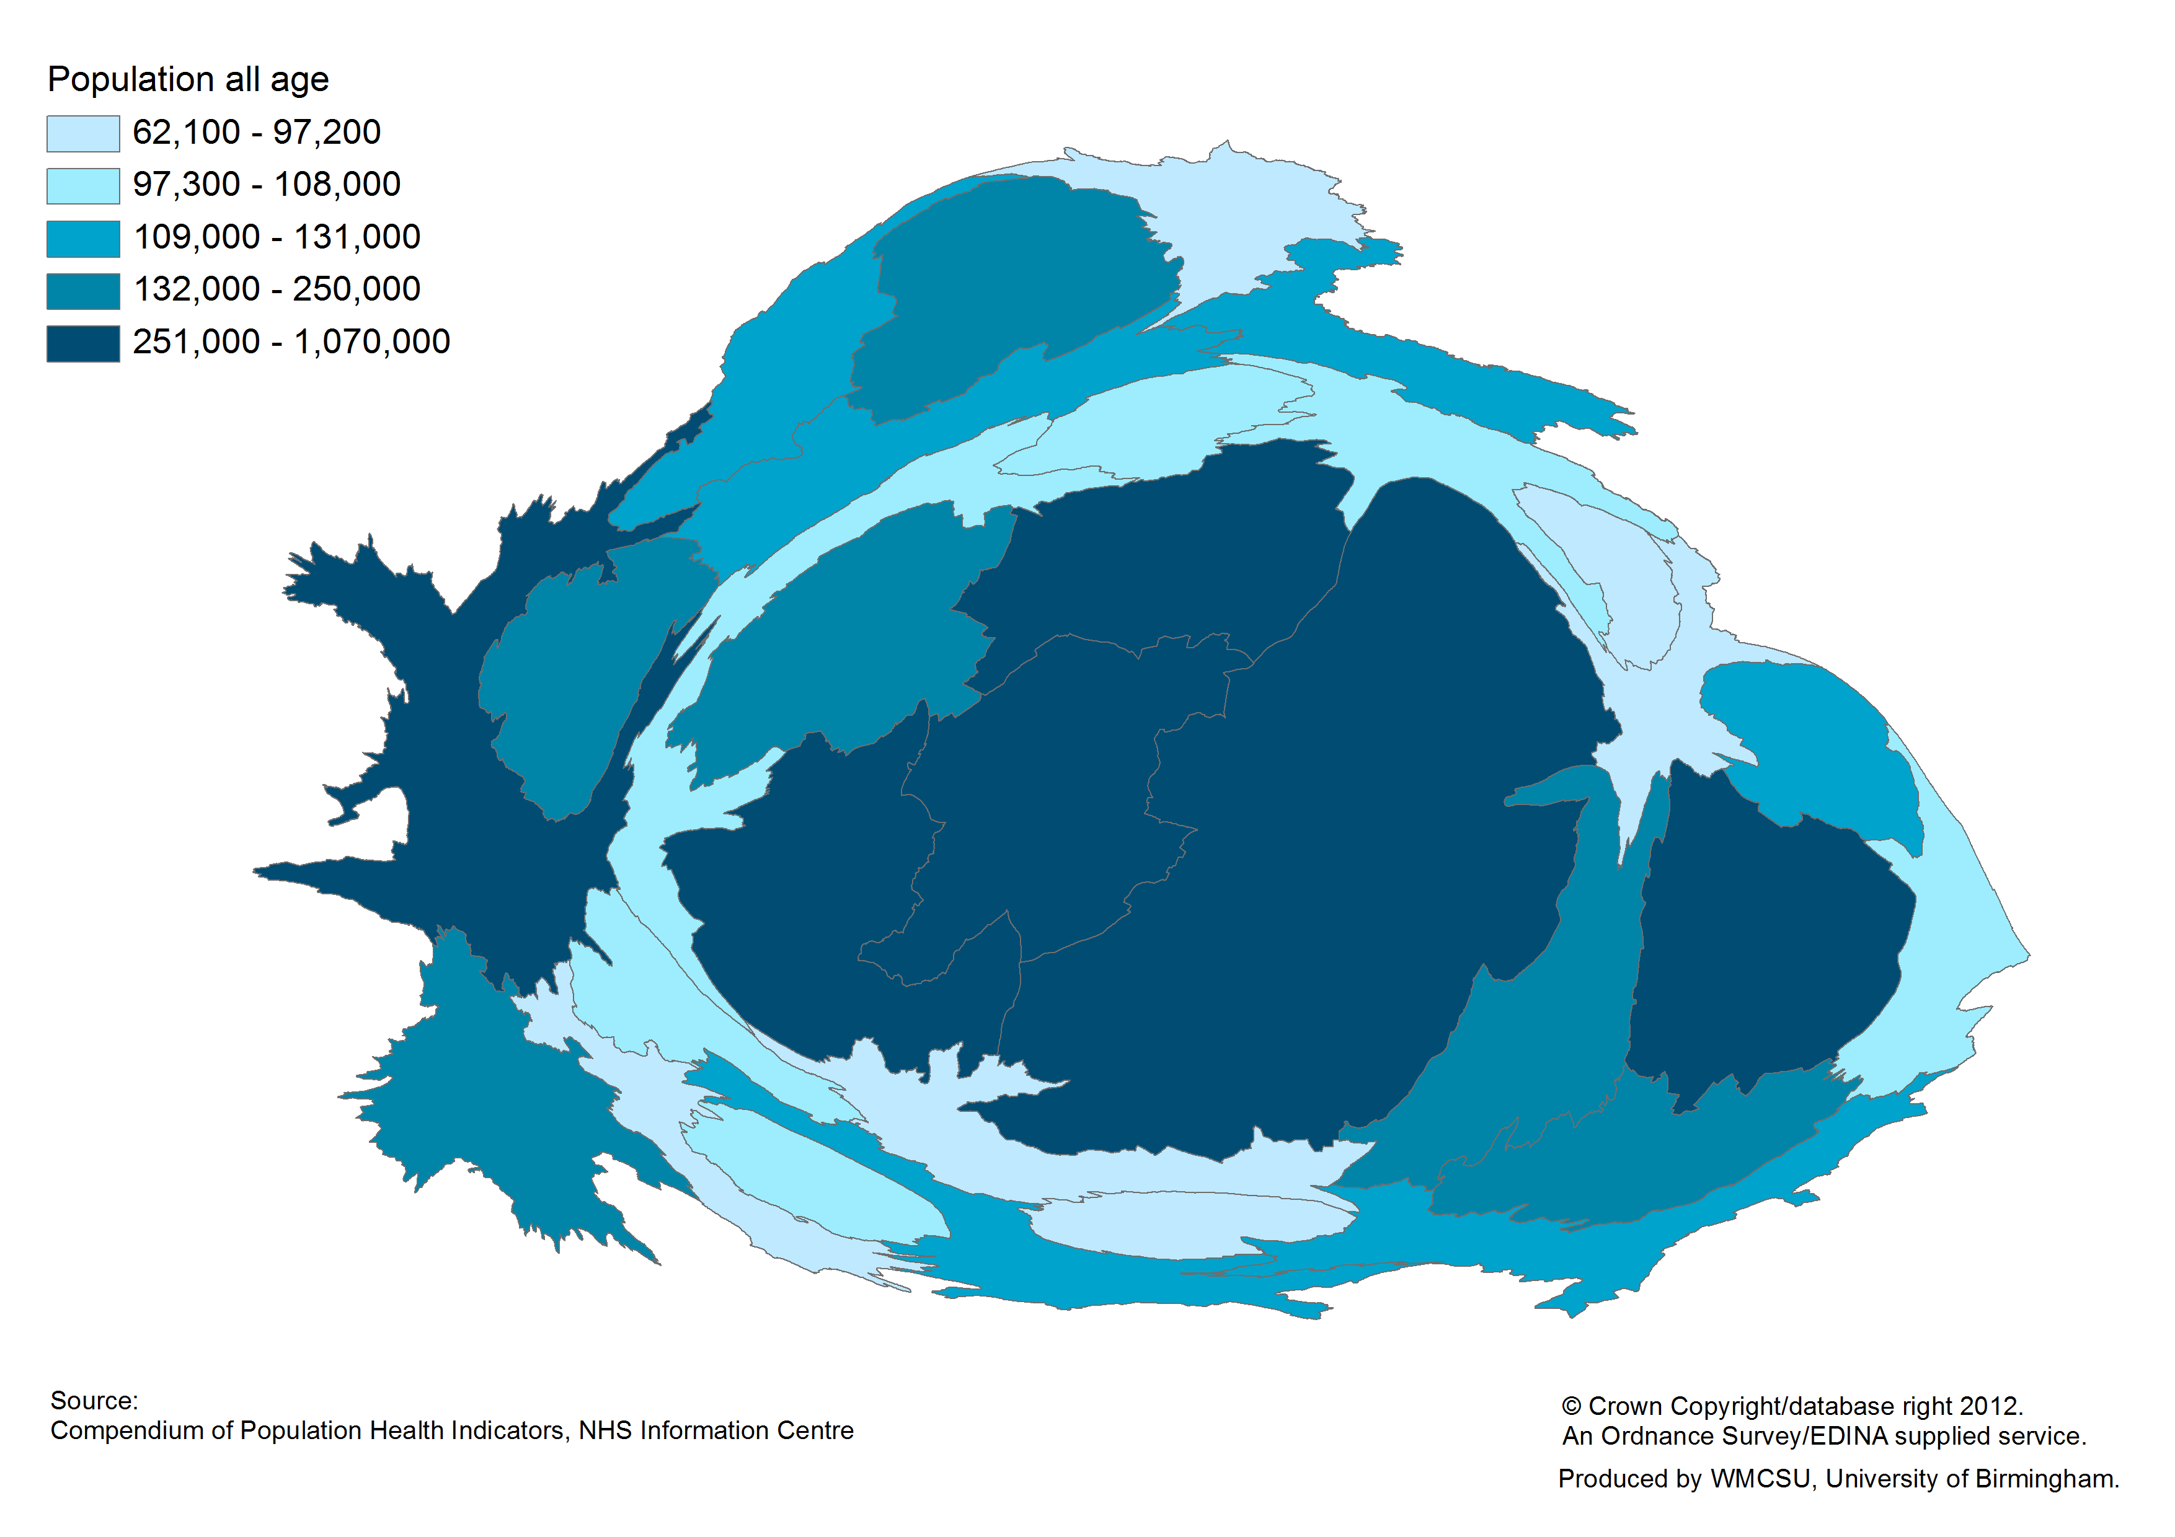
Density Weighted Mapping Techniques
Seeing West Midlands demography and health in a new way
Dr Christopher Chiswell; Jane Fletcher (WMCSU)
DORLING (2004) CARTOGRAM PRINCIPLES
Simple. Easy to understand & implement
Minimise Distortion, Preserve Legibility
Preserves accuracy. Maintains topology
Unambiguous,Projection Independent
Minimizes computational speed
Aesthetically acceptable
No overlapping regions
RESOURCES
See Chapter for method discussion and references
ArcGIS ESRI Script
Scapetoad (Standalone Java)
QGIS (Cartogram Creator)
Mapresso
Base geography: Midyear population estimates by local authority, all ages, West Midlands 2011
Population cartogram sized by: Midyear population estimates by local authority, all ages, West Midlands 2011
DELEGATE NOTES

Slide 2
Resources
How to Make Area Cartogram Maps in ArcGIS (Dempsey C, GIS Lounge).
Walkthrough including common pitfalls, in generating cartograms within ArcGIS.
Accessible at: http://www.gislounge.com/how-to-make-area-cartogram-maps-in-arcgis/
Scapetoad (Choros).
As well as providing freeware javascript transformation, includes references and links to developing cartogram techniques.
Accessible at: http://scapetoad.choros.ch/index.php
Indiemaps (Johnson Z).
Blog covering variety of techniques and tools for improving data visualisation.
Accessible at: http://indiemaps.com/blog/
Improving Visualisation (Dataviz).
Commissioned by the Department of Communities and Local Government and carried out by Oxford Consultants for Social Inclusion. Provides diverse examples of data visualisation relevant to the public sector at all levels, including case studies.
Accessible at: http://www.improving-visualisation.org/
Geographer At Large (Anon).
Blog posts on different mapping techniques, particularly in the context of New York. Quote: “Geography invariably leads to revolution”
Accessible at: http://geographer-at-large.blogspot.co.uk/2011_10_01_archive.html
Gapminder World (Gapminder Foundation).
Non profit venture promoting sustainable global development, with an interest in innovative data display.
Accessible at: http://www.gapminder.org/
MAPresso (Herzog A).
Downloadable Java applet that can be used to generate different cartogram formats, including ‘Dorling Cartograms’ on local shape files and data.
Accessible at: http://www.mapresso.com/
Handout References
Dorling D. Area Cartograms: Their Use and Creation. 1996. Concepts and Techniques in Modern Geography series no. 59, University of East Anglia: Environmental Publications.
Contact: christopher.chiswell@nhs.net

